Slide 1
Next Recommended Actions
Prepared by: Business Analytics Department
Date: 20th September 2021

Slide 2

Agenda:
01
Anatomy Of A Recommender System
02
Triggers And Actions
03
Model Performance And Validation
04
Modelling Flow
05
Business Impacts

Slide 3








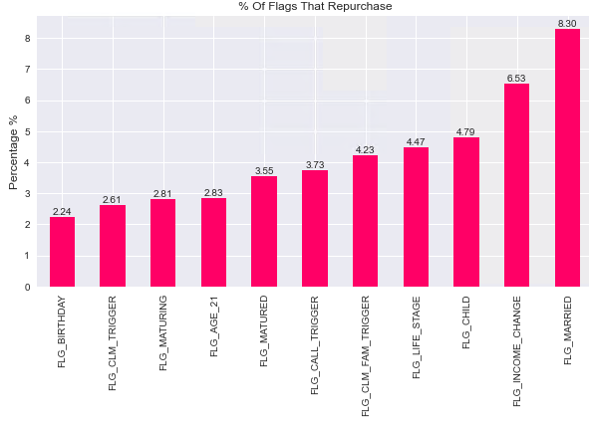
Anatomy Of The Recommender System
Demographics
Personalize Top 3 flags
Vitality
Insurance Coverage
marriage
Servicing Agent
NB Transactions
Claims
TensorREC / Deep Learning
Recommender System
Collaborative Filtering
Income change
child

Slide 4
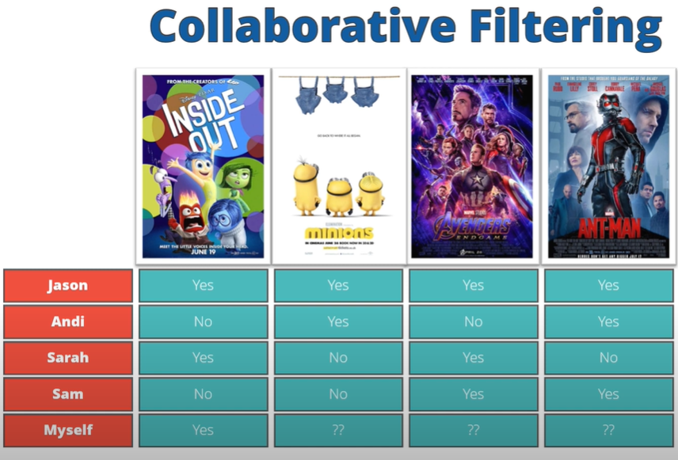
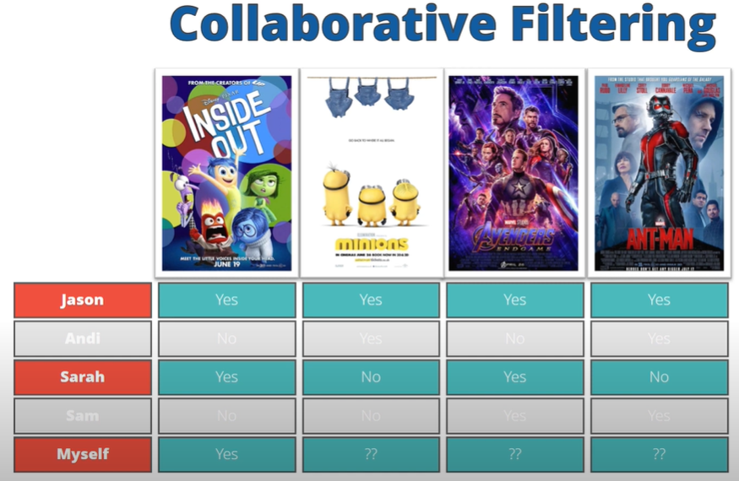
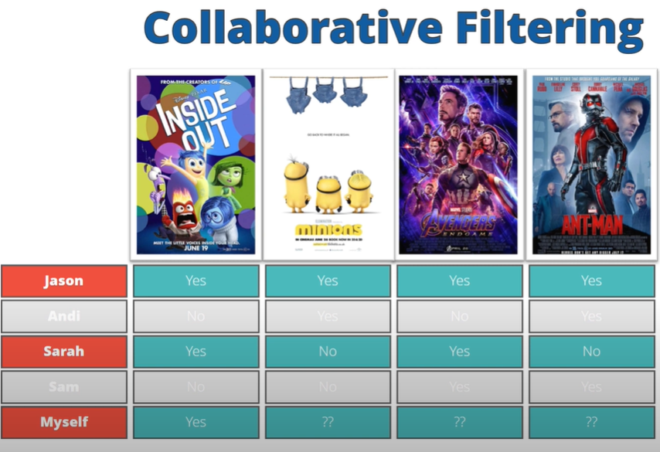
I like the ‘Inside Out’ movie
Jason, Sarah, Andi & Sam are in same cluster as me
Strike out Andi and Sam as they don’t like ‘Inside Out’
1 vote
2 votes
1 vote
Recommend Avengers for me as
Jason & Sarah are in same cluster with me
and both like ‘Inside Out’ and Avengers
Jason & Sarah both like Avengers

Slide 5
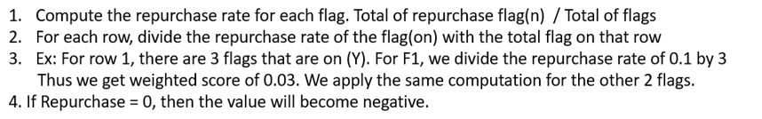
Collaborative Filtering
Predict the cross-sell triggers which would have higher likelihood for subsequent repurchase
1
Repurchase Rate: | 0.1 | 0.15 | 0.2 | 0.3
2
Customer | Flag 1 | Flag 2 | Flag 3 | Flag 4 | Repurchase
Cust A | Y | Y | Y | N | 0
Cust B | Y | Y | N | Y | 1
Cust C | Y | N | Y | N | 0
Cust D | Y | N | N | Y | 1
Customer | Flag 1 | Flag 2 | Flag 3 | Flag 4 | Repurchase
Cust A | -0.033 | -0.05 | -0.06 | 0 | 0
Cust B | 0.033 | 0.05 | 0 | 0.075 | 1
Cust C | -0.05 | 0 | -0.1 | 0 | 0
Cust D | 0.05 | 0 | N | 0.15 | 1
4
3

Slide 6










Triggers And Actions
Triggers - 11
Actions - 2
calls
life stage change / 21
birthday
Download My AIA App
income change
marriage
claims / family
Complete FHC
policy maturing/matured
child

Slide 7
RELEVANT To Repurchase
birthday
2
Income change
marriage
child
family claims
21
maturing
Age 17
Young Single
Mature Single
Mature Couple
Established Family
marriage
call

Slide 8




TRIGGER to Repurchase
life stage
Income change
Nest builder 34 yrs old
Young single from big city
child
fam claims
birthday

Slide 9
Model Performance and Validation
285k
With Cross Sell Triggers
89% (254k)
Top 3 Flags
Rightly Predicted
(regardless of ranking)
True Positive Rate
Top 3 Flags
with Ranking
Rightly Predicted
76% (217k)
NDCG – Normalize Discounted Cumulative Gain
Above is out-of-time validation based on Dec20 snapshot data versus Q1’21 repurchase

Slide 10
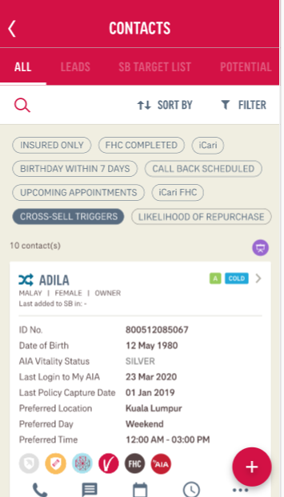



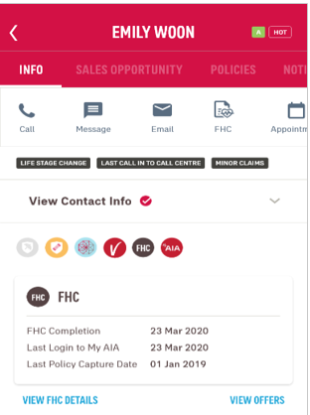
Modeling Flow: Hybrid of Model + Business Rules
ALPA
2
Data Driven Business Rules
to identify Priority of Remaining Cross Sell Triggers
3
Data Driven Business Rules
to identify Next Action,
i.e. download My AIA app, complete FHC
Recommender Model
on Cross Sell Trigger Priority
1

Slide 11
Business Impacts: Hybrid Model + Business Rules
Hybrid of Model + Business Rules bringing highest uplift in terms of repurchase rate (2.8x) & average repurchase ANP (1.7x) per quarter
1
2
1
2
3
Notes:
Uplift is identified by benchmarking against customers without Cross Sell Trigger flag
Above is out-of-time validation based on Dec20 snapshot data versus Q1’21 repurchase

Slide 12
Business Rules: Priorities
Priorities set based on business rules by referring to repurchase rate & average repurchase ANP post respective cross sell triggers
* Priorities are validated with Dec20 data versus Q1’21 repurchase (as presented above)

Slide 13
Business Rules: Actions
Recommend the actions based on business rules by referring to repurchase rate & average repurchase ANP post respective actions
Items | Download My AIA App | Complete FHC
Life Stage | Nest Builder & Established Family
Tenure | ≤ 2 Years | -
Recency | ≤ 3 Years | ≤ 10 Years
Vitality | Yes
Total ANP | RM8k+
Life Coverage | RM300k+ | RM500k+
CI Coverage | RM300k+
Medical Annual Limit | RM1m+
Flag if customers with either 3 of the criteria stated above

Slide 14
Appendices

Slide 15
Model Results

Slide 16
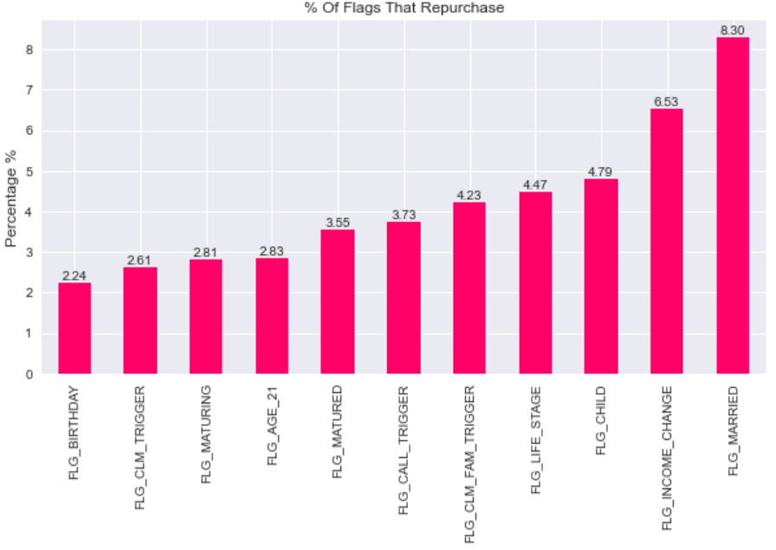
Repurchase Rate by Respective Cross Sell Triggers

Slide 17
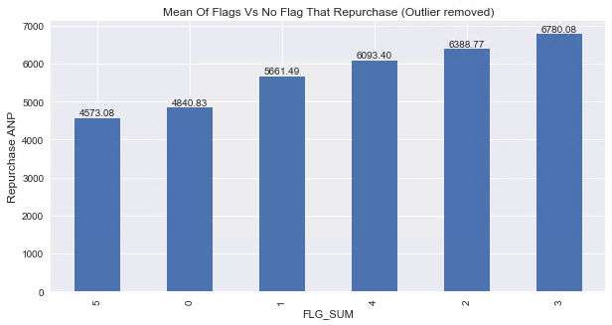
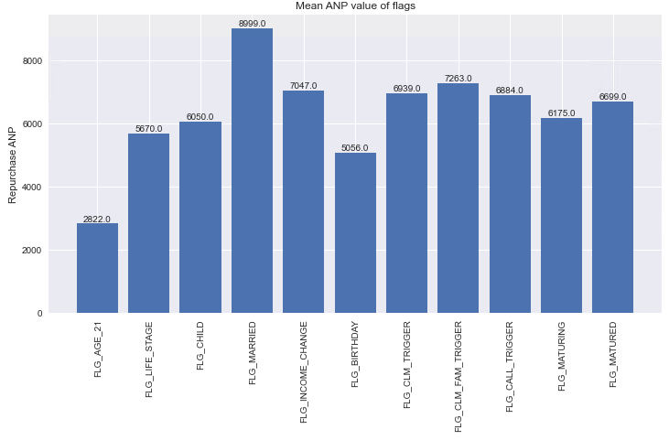
Repurchase ANP for Respective Cross Sell Triggers

Slide 18
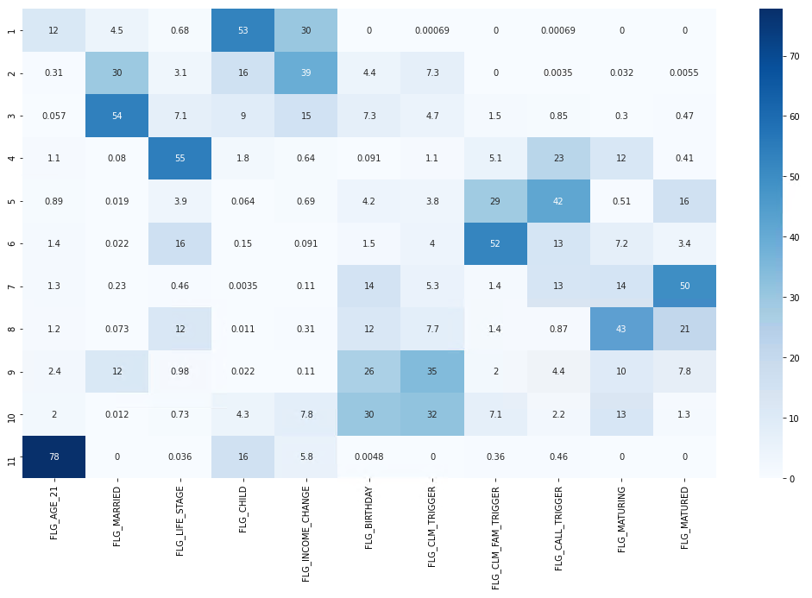
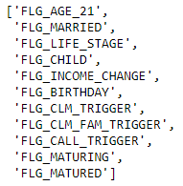
Ranking of Respective Cross Sell Triggers
Flags Ranking Distribution (%)
Ranking

Slide 19
Model Performance and Validation
NDCG – Normalize Discounted Cumulative Gain to measure ranking quality
Customer | Top 1 | Top 2 | Top 3
Cust A | F2 | F3 | F1
Cust B | F1 | F3 | F2
Cust C | F3 | F1 | F2
Ideal | F3 | F2 | F1
Repurchase Rate | 3% | 2% | 1%
Top 1 | Top 2 | Top 3 | Total
2 / 1 | 3 / 1.584 | 1 / 2 | 4.3928
1 / 1 | 3 / 1.584 | 2 / 2 | 3.8928
3 / 1 | 1 / 1.584 | 2 / 2 | 4.6309
3 / 1 | 2 / 1.584 | 1 / 2 | 4.7619
log(2) = 1 | log(3) = 1.584 | log(4) = 2
Sample Result
3
4.3928 / 4.7619 | 0.9225
3.8928 / 4.7619 | 0.8175
4.6309 / 4.7619 | 0.9724
4
NDCG = 0.9041
1
2
Identify the ideal ranking for each cross-sell triggers permutations, based on the repurchase rate
Higher weightage assigned to the ideal Top 1 flag
Compare respective customer’s predicted ranking versus the ideal ranking for same permutation
Derive the NDCG by getting the average from #3
Model Results:
NDCG = 0.76; True Positive Rate = 0.89
* 89% of the Top 3 flags are rightly predicted
*** model performance can improve with the augmented business rules

Slide 20
Action:
Download My AI / Complete FHC

Slide 21
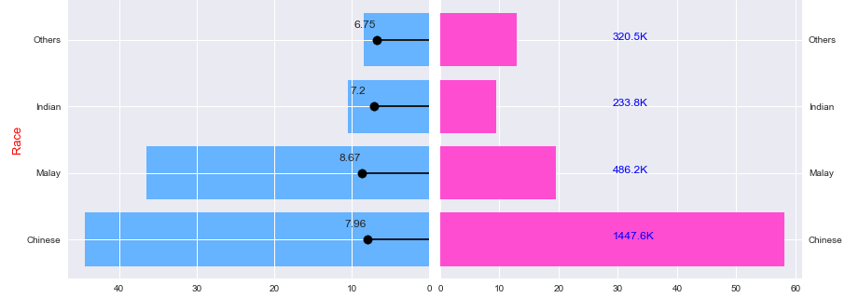
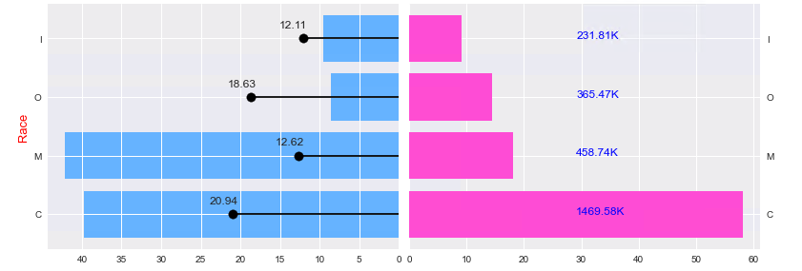
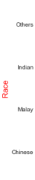
Malay has higher likelihood to download My AIA and complete FHC.
But, Chinese has higher repurchase rate after completing FHC
% Download My AIA (Repurchase Rate)
% Not Download My AIA (# Customers)
% Complete FHC (Repurchase Rate)
% Not Complete FHC (# Customers)

Slide 22
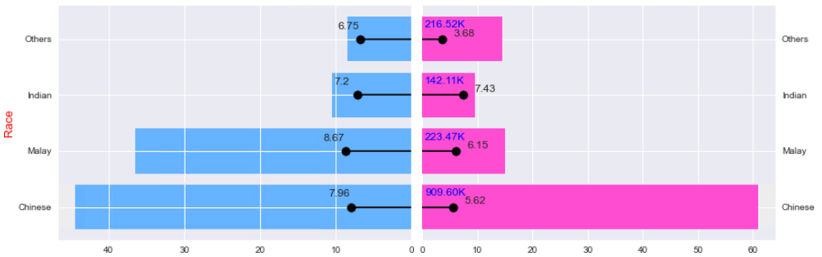
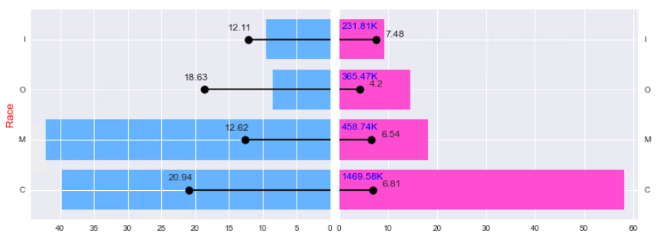
Malay has higher likelihood to download My AIA and complete FHC.
But, Chinese has higher repurchase rate after completing FHC
% Download My AIA (Repurchase Rate)
% Not Download My AIA (# Customers)
% Complete FHC (Repurchase Rate)
% Not Complete FHC (# Customers)
% Complete FHC (Repurchase Rate)
% Not Complete FHC (# Customers)

Slide 23
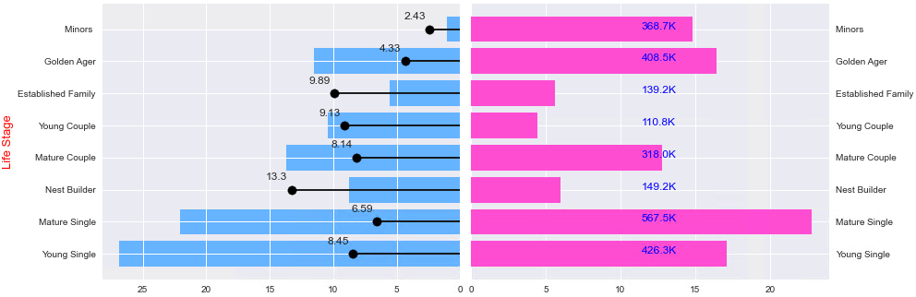
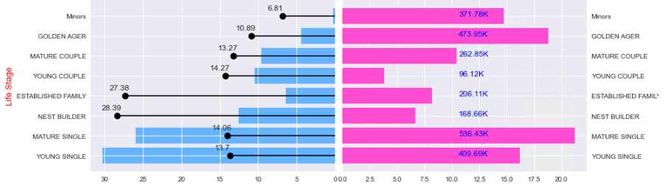
Married with Kids are having higher likelihood to for both actions with higher conversion rate
Young Single & Young Couple (18-35 y.o.) are having highest likelihood for both actions, but with lower conversion rate
% Download My AIA (Repurchase Rate)
% Not Download My AIA (# Customers)
% Complete FHC (Repurchase Rate)
% Not Complete FHC (# Customers)

Slide 24
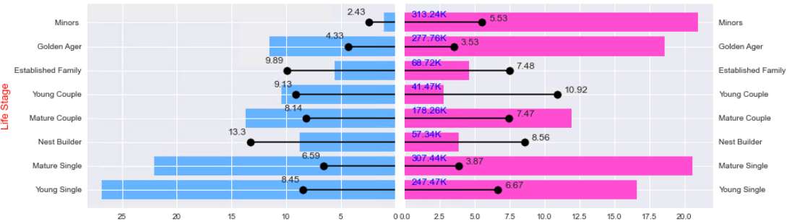
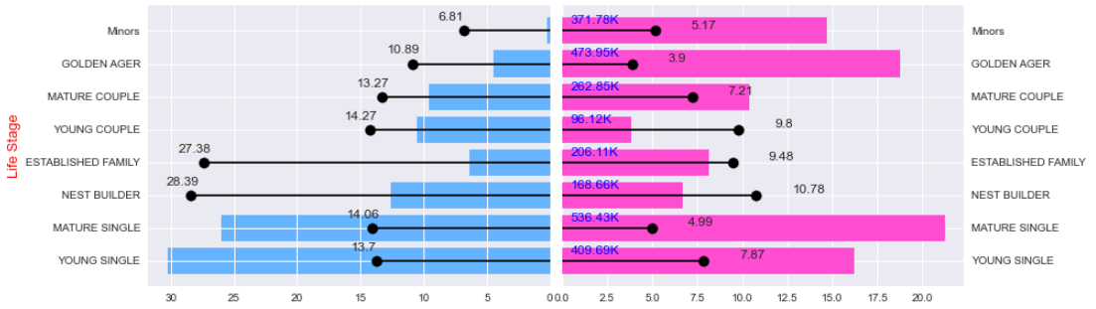
Married with Kids are having higher likelihood to for both actions with higher conversion rate
Young Single & Young Couple (18-35 y.o.) are having highest likelihood for both actions, but with lower conversion rate
% Download My AIA (Repurchase Rate)
% Not Download My AIA (# Customers)
% Complete FHC (Repurchase Rate)
% Not Complete FHC (# Customers)

Slide 25
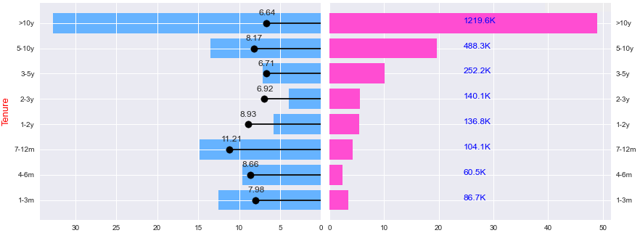
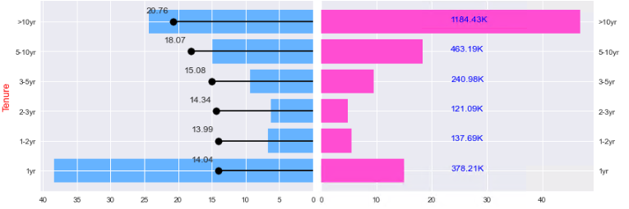
Newly joined customers in past 2 years have higher chance to download My AIA and with higher conversion rate after downloading My AIA
% Download My AIA (Repurchase Rate)
% Not Download My AIA (# Customers)
% Complete FHC (Repurchase Rate)
% Not Complete FHC (# Customers)

Slide 26
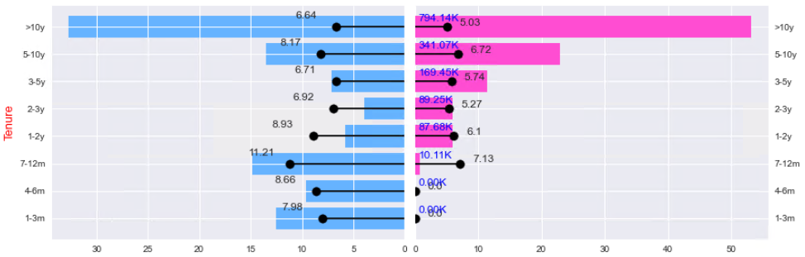
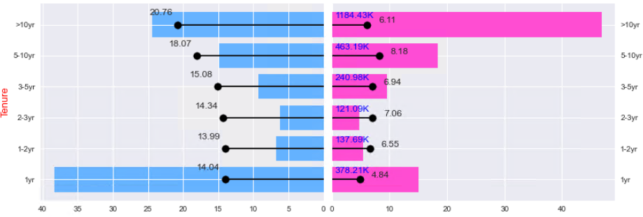
Newly joined customers in past 2 years have higher chance to download My AIA and with higher conversion rate after downloading My AIA
% Download My AIA (Repurchase Rate)
% Not Download My AIA (# Customers)
% Complete FHC (Repurchase Rate)
% Not Complete FHC (# Customers)

Slide 27
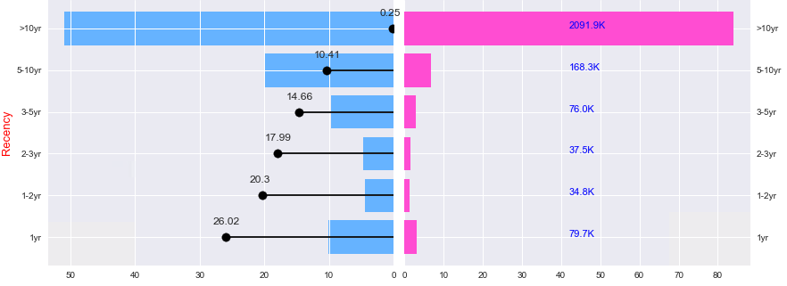
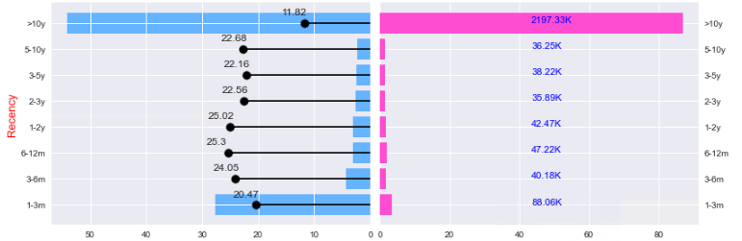
Active customers with recency ≤ 3 years have higher conversion rate after downloading My AIA; for those with recency ≤ 10 years have higher likelihood to download My AIA
Those with recency ≤ 10 years have higher likelihood to complete FHC & with higher conversion rate
% Download My AIA (Repurchase Rate)
% Not Download My AIA (# Customers)
% Complete FHC (Repurchase Rate)
% Not Complete FHC (# Customers)

Slide 28
Active customers with recency ≤ 3 years have higher conversion rate after downloading My AIA; for those with recency ≤ 10 years have higher likelihood to download My AIA
Those with recency ≤ 10 years have higher likelihood to complete FHC & with higher conversion rate
% Download My AIA (Repurchase Rate)
% Not Download My AIA (# Customers)
% Complete FHC (Repurchase Rate)
% Not Complete FHC (# Customers)

Slide 29
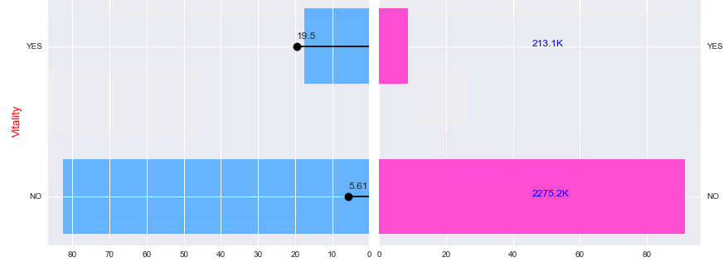
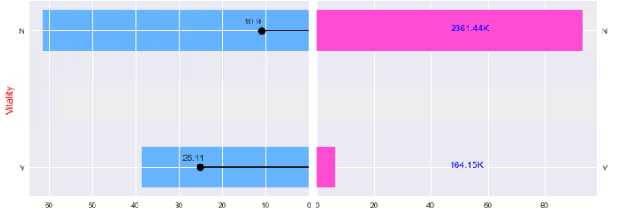
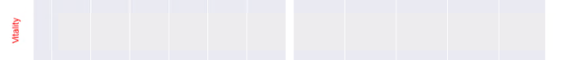
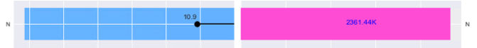
Vitality members are with higher likelihood for both actions and conversion rate after the respective actions
% Download My AIA (Repurchase Rate)
% Not Download My AIA (# Customers)
% Complete FHC (Repurchase Rate)
% Not Complete FHC (# Customers)

Slide 30
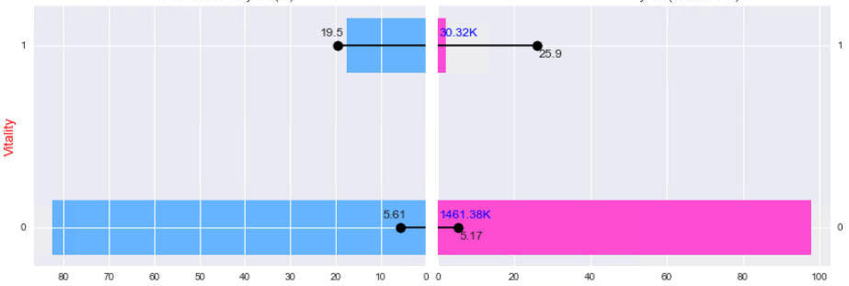
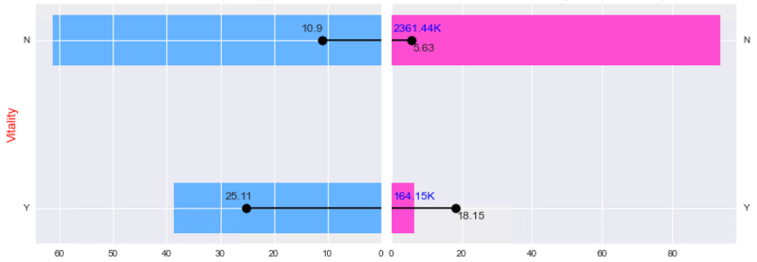
Vitality members are with higher likelihood for both actions and conversion rate after the respective actions
% Download My AIA (Repurchase Rate)
% Not Download My AIA (# Customers)
% Complete FHC (Repurchase Rate)
% Not Complete FHC (# Customers)

Slide 31
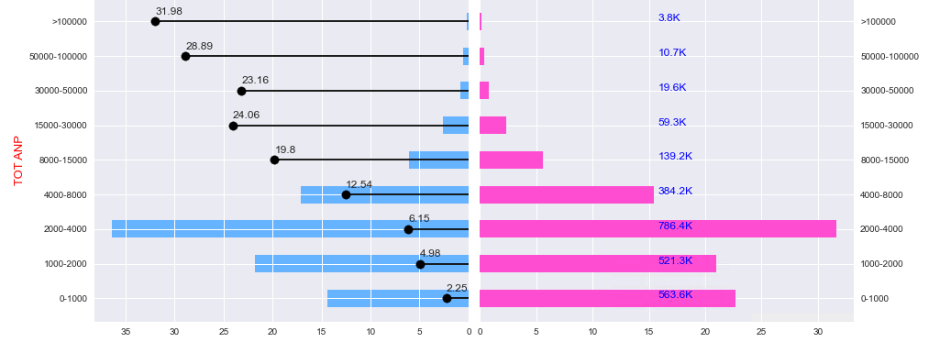
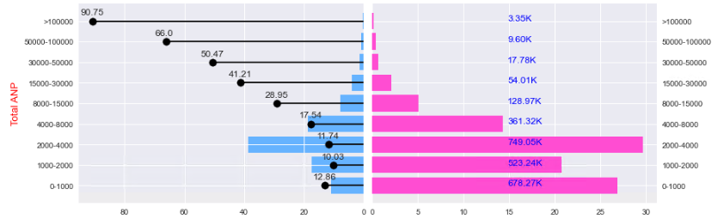
Customers with total ANP of RM8k+ are having higher likelihood for both actions and conversion rate after the respective actions
% Download My AIA (Repurchase Rate)
% Not Download My AIA (# Customers)
% Complete FHC (Repurchase Rate)
% Not Complete FHC (# Customers)

Slide 32
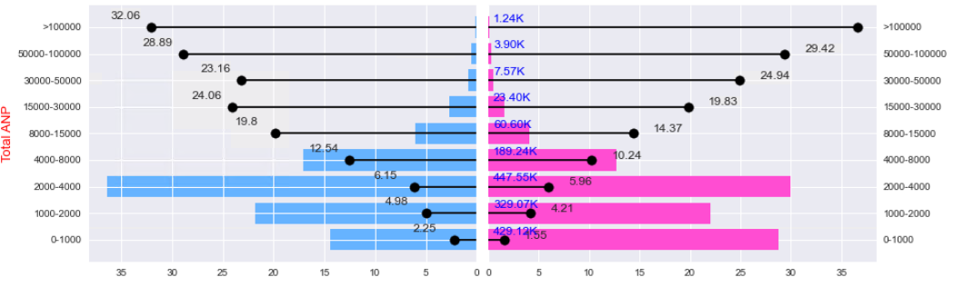
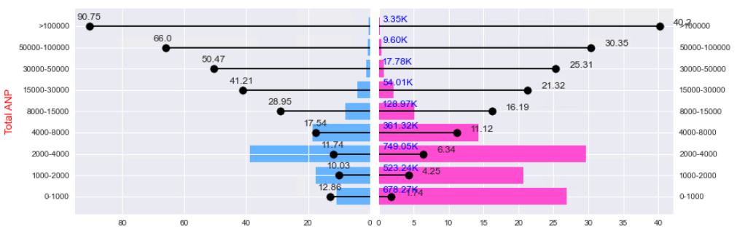
Customers with total ANP of RM8k+ are having higher likelihood for both actions and conversion rate after the respective actions
% Download My AIA (Repurchase Rate)
% Not Download My AIA (# Customers)
% Complete FHC (Repurchase Rate)
% Not Complete FHC (# Customers)

Slide 33
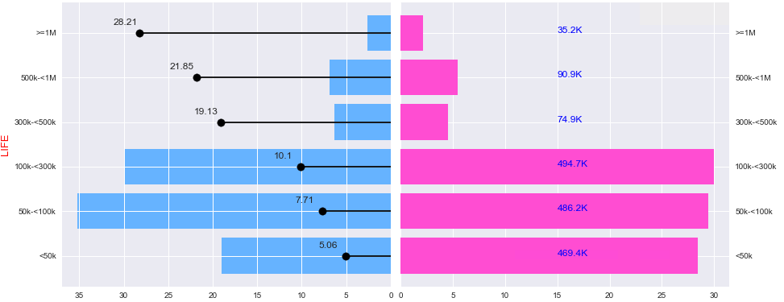
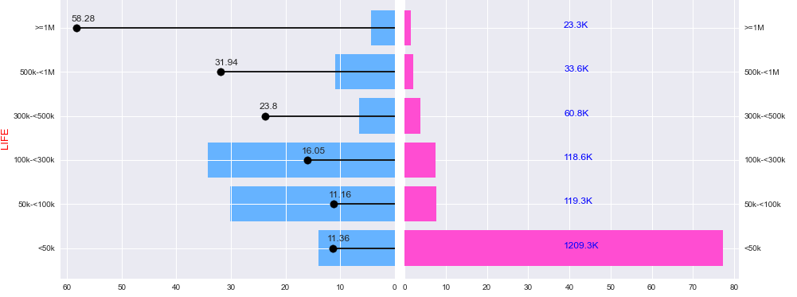
Customers with Life coverage of RM300k+ are having higher likelihood to download My AIA and post repurchase with higher ANP
When referring to those completing FHC, this only applicable to customers with Life coverage of RM500k+
% Download My AIA (Repurchase Rate)
% Not Download My AIA (# Customers)
% Complete FHC (Repurchase Rate)
% Not Complete FHC (# Customers)

Slide 34
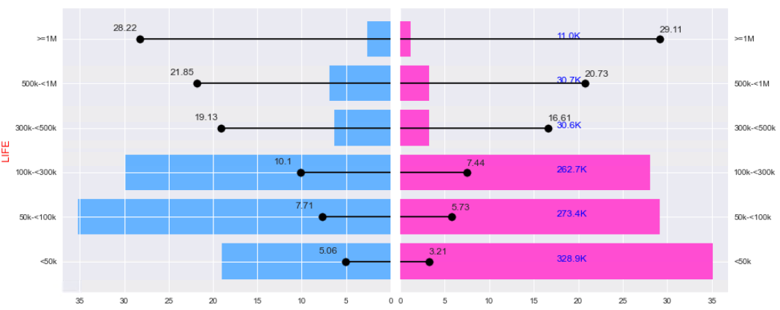
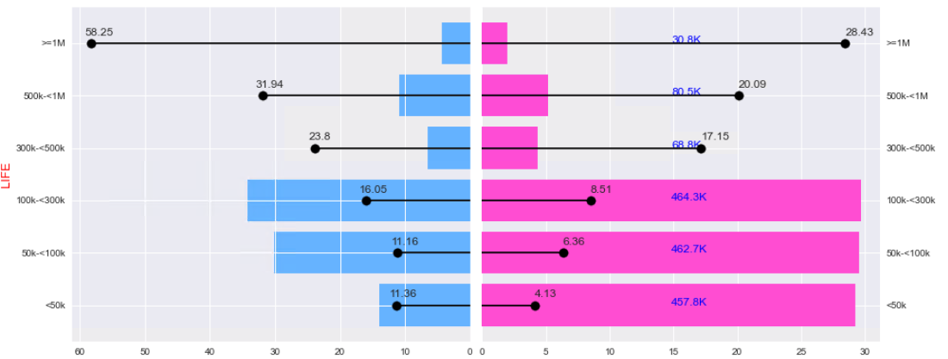
Customers with Life coverage of RM300k+ are having higher likelihood to download My AIA and post repurchase with higher ANP
When referring to those completing FHC, this only applicable to customers with Life coverage of RM500k+
% Download My AIA (Repurchase Rate)
% Not Download My AIA (# Customers)
% Complete FHC (Repurchase Rate)
% Not Complete FHC (# Customers)

Slide 35
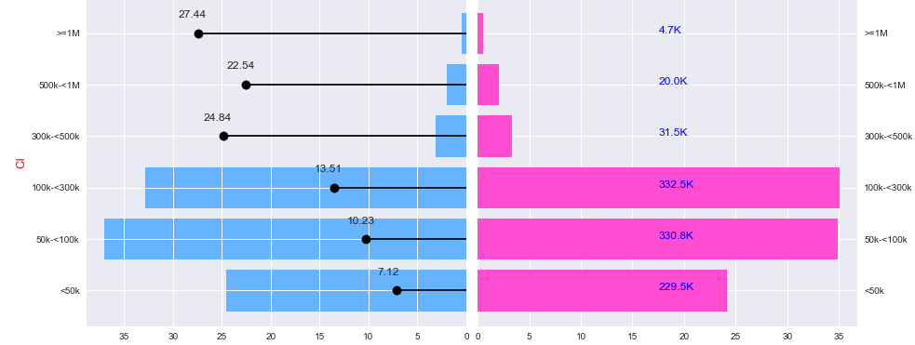
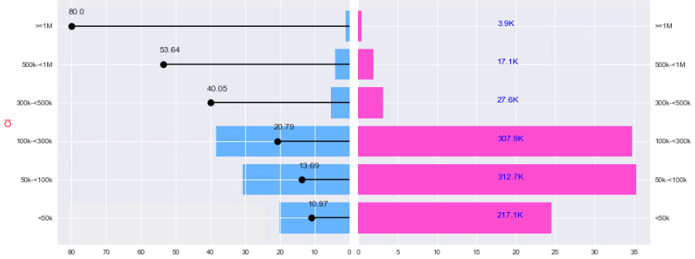
Customers with CI coverage of RM300k+ are having higher likelihood for both actions and post repurchase with higher ANP
% Download My AIA (Repurchase Rate)
% Not Download My AIA (# Customers)
% Complete FHC (Repurchase Rate)
% Not Complete FHC (# Customers)

Slide 36
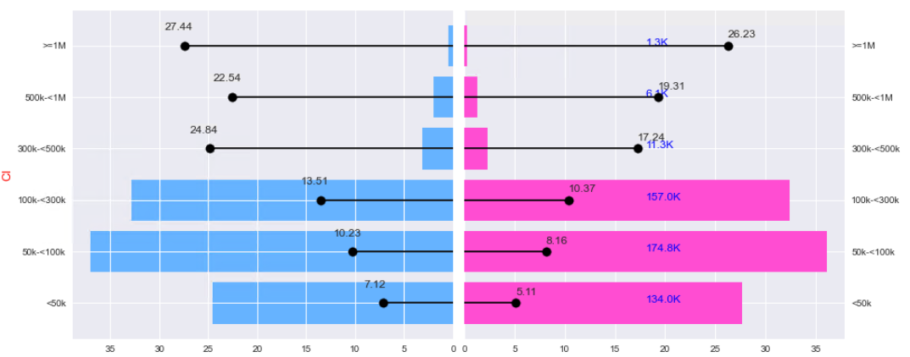
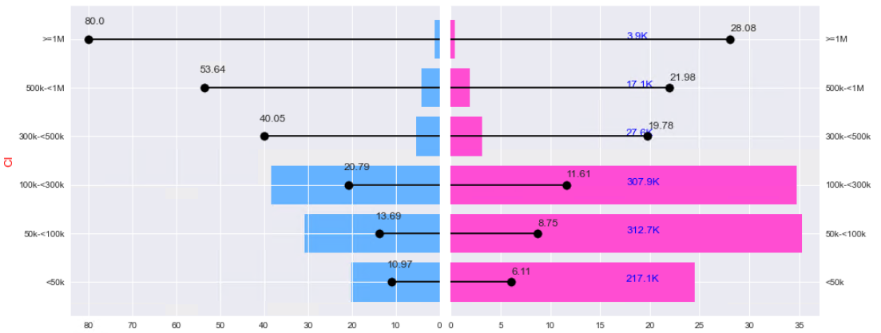
Customers with CI coverage of RM300k+ are having higher likelihood for both actions and post repurchase with higher ANP
% Download My AIA (Repurchase Rate)
% Not Download My AIA (# Customers)
% Complete FHC (Repurchase Rate)
% Not Complete FHC (# Customers)

Slide 37
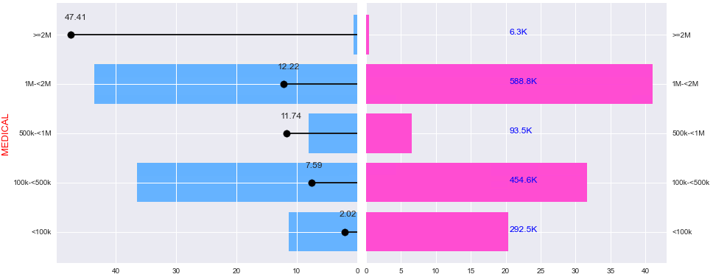
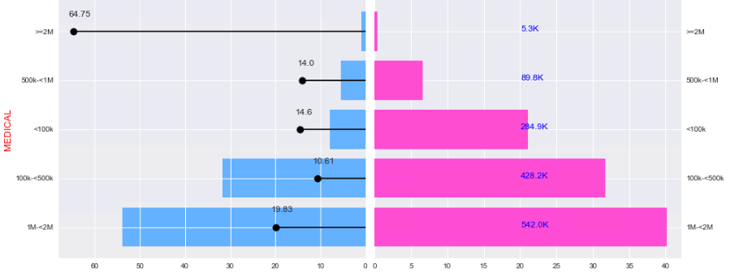
Customers with Medical Annual Limit of RM1m+ are having higher likelihood for both actions and post repurchase with higher ANP
% Download My AIA (Repurchase Rate)
% Not Download My AIA (# Customers)
% Complete FHC (Repurchase Rate)
% Not Complete FHC (# Customers)

Slide 38
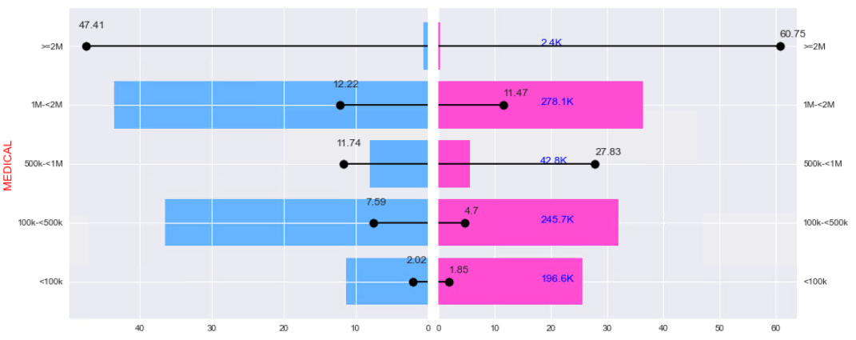
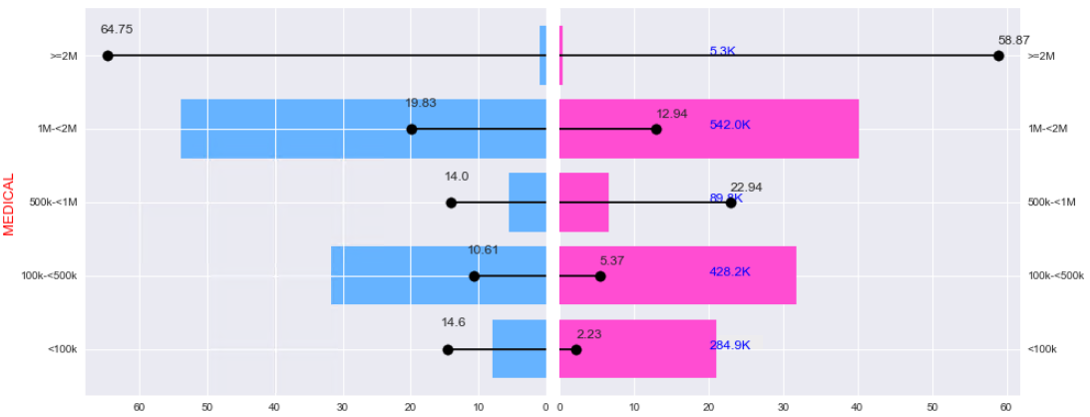
Customers with Medical Annual Limit of RM1m+ are having higher likelihood for both actions and post repurchase with higher ANP
% Download My AIA (Repurchase Rate)
% Not Download My AIA (# Customers)
% Complete FHC (Repurchase Rate)
% Not Complete FHC (# Customers)

Slide 39
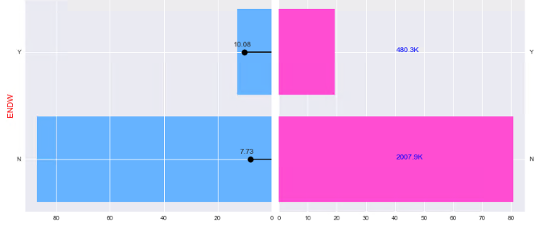

Those with Endowment plans are with lower likelihood for both actions, but with higher conversion rate after respective actions
% Download My AIA (Repurchase Rate)
% Not Download My AIA (# Customers)
% Complete FHC (Repurchase Rate)
% Not Complete FHC (# Customers)

Slide 40


Those with Endowment plans are with lower likelihood for both actions, but with higher conversion rate after respective actions
% Download My AIA (Repurchase Rate)
% Not Download My AIA (# Customers)
% Complete FHC (Repurchase Rate)
% Not Complete FHC (# Customers)

Slide 41



Correlation and significance of variables to the Repurchase ANP

Slide 42



Slide 43


Slide 44


Model Performance and Validation
NDCG – Normalize Discounted Cumulative Gain to measure ranking quality
Standard position denominator in the NDCG formula
MODEL Performance = 0.756
Recall = 0.89
*** model performance can improve with the augmented business rules

Slide 45


Modeling Flow
Data driven business rules
My AIA / FHC
ALPA
Top 3 Flags

Slide 46
Model Impact
Customers with priorities identified and set from the models are having higher uplift in terms of repurchase rate (2x) & average repurchase ANP (1.5x) per quarter
Notes:
Uplift is identified by benchmarking against customers without Cross Sell Trigger flag
Above is out-of-time validation based on Dec20 snapshot data versus Q1’21 repurchase

